Slide 1

ETL Pipeline for Protein Data Integration
A Comprehensive Approach

Slide 2
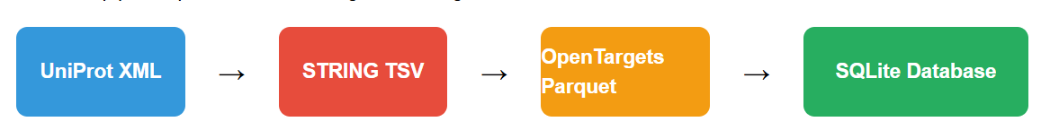
Project Overview
This ETL pipeline processes and integrates biological data from three sources:
Key Requirements:
Extract specific fields from each source
Transform and clean the data
Load into a structured database with multiple layers
Create a semantic layer with integrated protein information
Ensure code quality, documentation, and unit testing

Slide 3
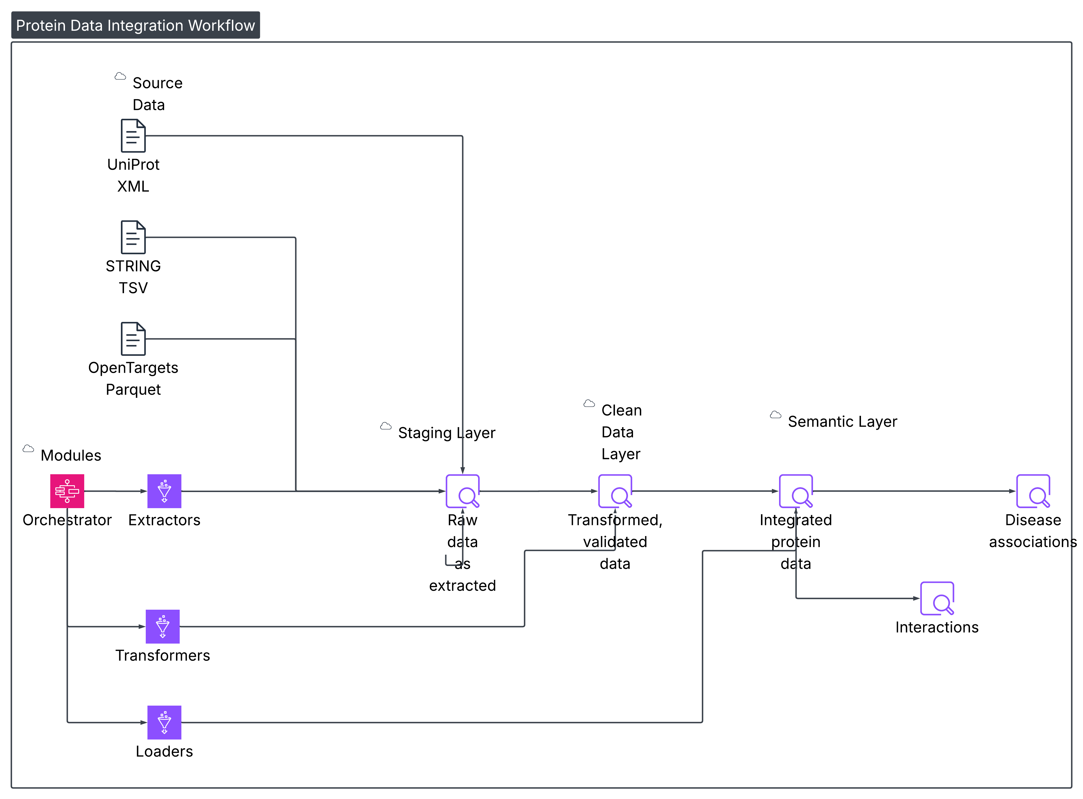
Architecture

Slide 4
Technical Approach
Design Principles
Modularity: Each component has a single responsibility
Memory Efficiency: Streaming parsers for large files
Error Handling: Robust error capture and logging
Scalability: Design allows for future extensions
Testability: Components designed for easy unit testing
Technologies
Python: Core language for ETL processes
lxml: Efficient XML parsing with iterparse
pandas: Data manipulation for tabular data
pyarrow: Parquet file processing
SQLite: Database for storing processed data
pytest: Testing framework

Slide 5
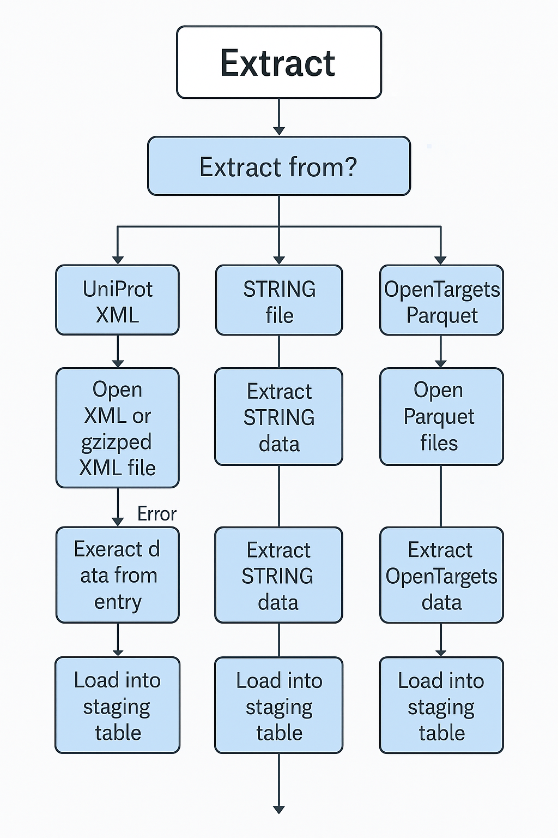
Extract.py Flowchart :

Slide 6
UniProt Extractor Implementation
Memory-Efficient XML Processing
Key Implementation Features
Streaming Parser for Large Files The extractor uses lxml's iterparse to process the 8GB+ UniProt XML file incrementally, reading one protein entry at a time rather than loading the entire document into memory. This approach enables processing of extremely large files with minimal memory footprint, making the solution scalable to the full dataset.
Element-Level Memory Management After processing each protein entry, the extractor explicitly clears the element from memory using elem.clear() and removes parent references. This prevents memory buildup during parsing, maintaining constant memory usage regardless of file size.
Precise Field Extraction Using targeted XPath expressions, the extractor navigates the complex XML structure to extract specific required fields like accession numbers, protein names, and database cross-references, handling cases where elements may be missing.
API Fallback with Rate Limiting The extractor supports the UniProt REST API as an alternative to XML parsing, with built-in rate limiting to respect the 200 requests/second constraint and pagination to retrieve all results.
Error Resilience Error handling is complete and thorough, catching errors while processing individual entries and allowing the pipeline to continue without bringing down the entire process, but logs all details to capture any specific issues encountered.

Slide 7
STRING and OpenTargets Data Processing
STRING Extractor
OpenTargets Extractor
The STRING extractor uses chunked processing to parse large (multi gigabyte) tab-separated files. They read the file one chunk at a time (100,000 rows), apply filtering criteria to the chunk, then concatenate the filtered results. There are very reasonable memory use when processing millions of protein interactions and high performance.
ScoreBased Filtering…Implements filtering logic that allows only high confidence protein interactions with combined scores above the specific threshold (default 200). This has the effect of greatly reducing the size of the dataset as retrieved from post, while retaining the most scientifically relevant interactions, both improving storage efficiency and analysis quality.
The STRING protein identifiers are first transformed from their native format (for example, "9606.ENSP00000123456") to match UniProt accession numbers used all throughout the pipeline. Standardization of this database allows the proteins and their interactions to be mapped and their data to be mapped accurately into the integrated database in order for consistency of data across different data sources.
The OpenTargets extractor makes uses of PyArrow’s optimized Parquet reader together with column selection ( loading only the desired columns like 'id', 'approvedSymbol', 'biotype' for targets) to save memory over the whole file loading. The large, feature rich OpenTargets datasets require such a selective approach.
Provides efficient merging strategy, three different datasets (targets, diseases and associations) are merged by optimized merge operations. Integrating these would bring together a single view of disease associations, keeping the necessary fields intact for further processing and reference.
Carefully preserves quantitative association scores between targets and diseases across the course of the transformation preserving an ability for semantic layer queries to for instance prioritize most significant disease relationships. Furthermore, these scores can give some insight to researchers studying about protein-disease relations.

Slide 8
Key Challenges & Solutions
Challenge 1: UniProt XML file is large (>8GB) and cannot be loaded entirely into memory
Solution: Use lxml's iterparse with clear() to process the file incrementally, releasing memory after each protein entry
Challenge 2: Integration of heterogeneous data formats (XML, TSV, Parquet)
Solution: Format-specific extractors with consistent output structures for downstream processing
Challenge 3: Handling potential missing or invalid data
Solution: Robust validation and transformation logic with comprehensive error handling
Challenge 4: OpenTargets API rate limiting (200 requests/second)
Solution: Implement throttling mechanisms and batch processing where needed

Slide 9
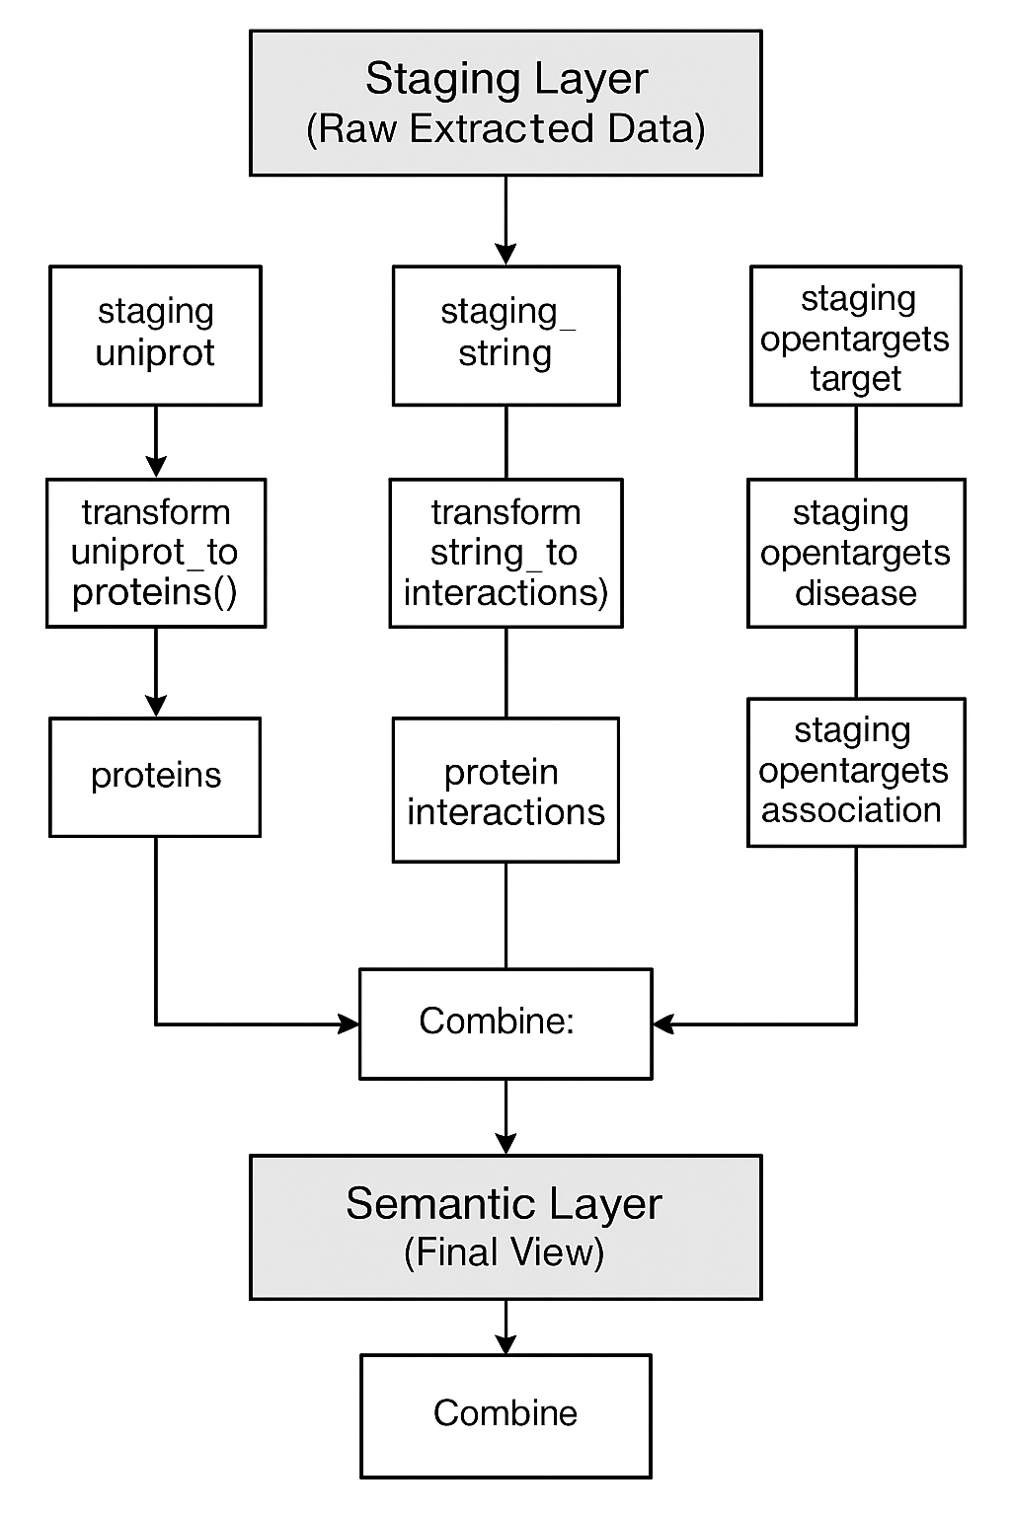
Transform.py Flowchart :

Slide 10
Database Schema
Three-Layer Architecture Design
The staging layer is populated with raw data from source files with little transformation. Protein information (accession numbers, names, sequence properties, etc.) is extracted and saved in the staging_uniprot table along with the original data as JSON for reference. Protein-related protein interactions with confidence score and target (diseases) related associations with supporting evidence score are stored in staging_string and staging_opentargets tables respectively. At the top level, you have a data landing zone that preserves the original extracted information before it goes through the further processing.
The clean layer applies data validation, standardization and relationship modeling. The proteins table, contains validated protein entries with a consistent format without duplicates in terms of primary accession. Therefore, it serves as the central reference point with a unique key. foreign keys are implemented in the clean_interactions table to make sure that interactions are only pointing to existing proteins and clean_disease_associations is a validated view of disease relationships. This layer is the "single source of truth" with data quality controls on the data and properly modeled relationships.
Semantic Layer Table An integrated view is made available for consumption by the semantic layer. In the semantic_protein_data table, there is 1 row per protein, containing core protein properties and 2 JSON fields (columns): associated_diseases stores an array of disease objects with identifiers, names and association scores; strong_interactions contains an array of interacting proteins with their confidence scores. As it turns out this denormalized design favors simplicity of queries and you can completely get protein information along with related entities in a single query.

Slide 11
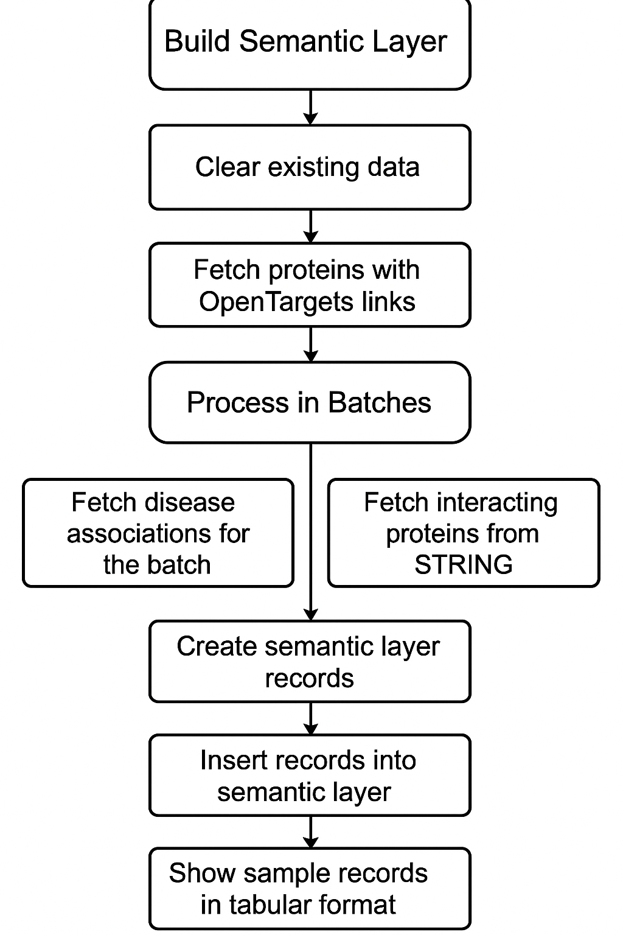
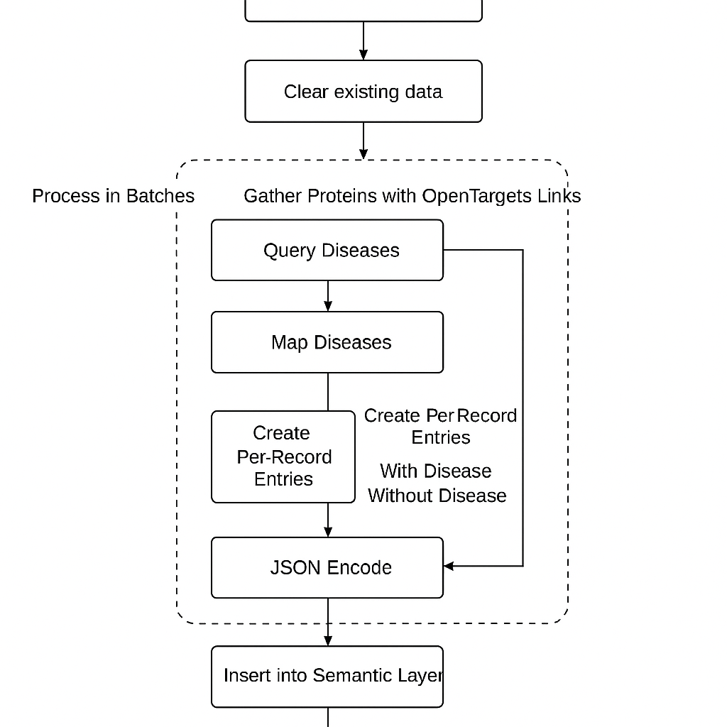
Load.py Flowchart :

Slide 12
Overview:
Clear existing semantic data
Fetch all proteins with OpenTargets link
For each batch of proteins (100 at a time):
Get their disease associations
b. Get interacting proteins
Create semantic rows
For each protein in the batch:
Get its:
Disease list
Interacting proteins list
Store everything in ProteinDieaseNetwork
Insert batch to database
Log total count and show samples

Slide 13
Semantic Layer Integration
Creating the Unified Data View
The semantic layer uses JSON arrays to represent one-to-many relationships as part of very sophisticated denormalization: Each protein disease and protein protein interactions are converted to structured JSON objects covering all material attributes. It combines the benefits of relational integrity with efficiency of queries, so that complete protein information can be retrieved in one go without complex joins. Disease objects contain disease identifiers and names as well as association scores and interaction objects contain protein accessions and names as well as confidence scores.
Integration process resolves cross reference between different data sources to connect proteins with appropriate entity, by using identifier mapping. Instead opentargets_id field in the protein record links OpenTargets disease associations and STRING interactions are joined by primary accession matching. The resolution process guarantees that only valid and relevant relationships are included in the semantic layer giving rise to a trusted biological network of each protein entry.
The semantic layer design powers powerful, integrated queries impossible across multiple, disparate data sources. Now they can find which proteins in those pathways are associated with specific diseases, as well as looking at interaction partners in a single query. Support for sophisticated filtering scenarios is offered by this integration, for example, finding proteins with strong disease associations (high OpenTargets scores) that correspond to strong interactors with other specific proteins (high STRING confidence scores), a comprehensive resource for exploring and discovering biological data.

Slide 14
Testing Approach
Unit Tests
Extractors: Verify correct data extraction from sample files
Transformers: Test data cleaning and validation logic
Loaders: Ensure proper database loading operations
Edge Cases: Test handling of missing/malformed data
Integration Tests
End-to-End: Test full pipeline with sample data
Database Validation: Verify data integrity across layers
Performance: Ensure memory efficiency with large files

Slide 15
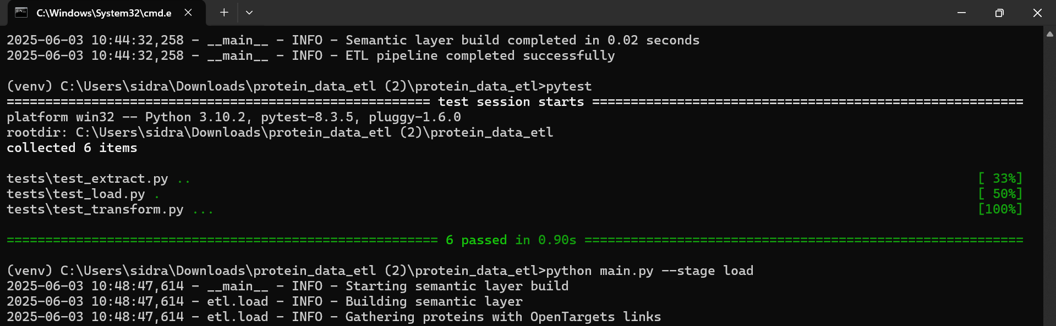
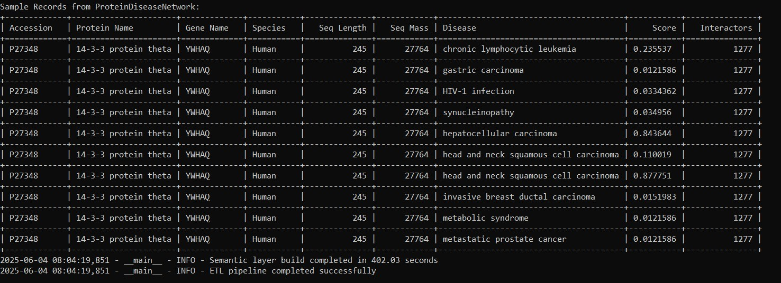
RESULT:

Slide 16
Orchestration
Pipeline Coordination and Management
Modular Component Orchestration The pipeline orchestrator takes care to sequence all ETL components in a structured manner to ensure the flow of data from extraction to transformation to loading. It configures each component with appropriate configurations, transfers data among the stages and does the right management of the resources in the pipe line. Such a design is modular, so each component can be developed, tested and maintained separately from the others and the orchestrator brings it all together. It respects sequence carefully such that the upstream operations are completed before the dependent down stream process begin.
The orchestrator manages memory usage by implementing batch processing with detailed progress tracking to give more visibility into long running operations. Data from UniProt is split into configurable batches (default 1000 entries), each batch processed by extraction, transformation and loading before the next batch starts. Progress logs are regular, reporting completion milestones (e.g., "Processed 10,000 UniProt entries") which provides operators a view on how far the pipeline has progressed and when it is estimated to be completed for large pipelines – the full UniProt dataset has hundreds of thousands of entries.
Error Handling and Recovery The orchestrator has comprehensive error handling at multiple levels like if record processing fails on a single record or component fails all together. If errors occur in the system it saves full diagnostics and successfully processed data and can optionally proceed to subsequent pipeline steps. The graceful degradation approach guarantees that a problem in one data source (i.e. malformed XML in one UniProt entry) will not impair the whole pipeline, thus providing maximum data completeness with transparent error reporting for further troubleshooting and resolution.

Slide 17

Conclusion
Key Achievements
Created a robust ETL pipeline for biological data integration
Implemented memory-efficient processing for large XML files
Designed a modular, maintainable codebase with clear separation of concerns
Established a three-layer data architecture with clean transformations
Implemented comprehensive error handling and testing
Produced a semantic layer that integrates all required protein data
The solution provides a solid foundation for biological data integration that can be extended for future requirements and scaled for larger datasets.

